Slide 1


IMPLEMENTATION OF K-MEANS AND K-MEDOID CLUSTERING ALGORITHMS
Project Lab (CS 794) Group 4
Anisha Pal 14400113005
Supervised by Prof Subrata Bose
Department of Computer Science and Engineering
Neotia Institute of Technology, Management and Science
November 2016
7th Semester, 2013-2017 Batch

Slide 2
Contents
What is Clustering?
Applications of Clustering
Clustering Mechanisms
K-Means Clustering
Drawbacks of K-Means
K-Medoids
K-Mean vs K-Medoids
Elbow Method
Progress and Future Plans
Conclusion
References

Slide 3
What is Clustering?
Originated from “clyster”, meaning “clot”.
Cluster analysis or clustering is the task of grouping a set of objects in such a way that objects in the same group (called a cluster) are more similar (in some sense or another) to each other than to those in other groups (clusters).

Slide 4
Application of Clustering
Market research, pattern recognition and data analysis
Characterization of the customer groups based on the purchasing patterns.
Derivation of plant and animal taxonomies
Classifying documents on the web for information discovery.
Earth-quake studies
Climate: understanding earth’s climate, finding patterns of atmospheric and ocean.
Machine Vision and Image Processing.
Outlier Detection.

Slide 5
Clustering Mechanisms
Partitioning method
K-means algorithm
K-medoids algorithm
Hierarchical method
Agglomerative
Divisive

Slide 6
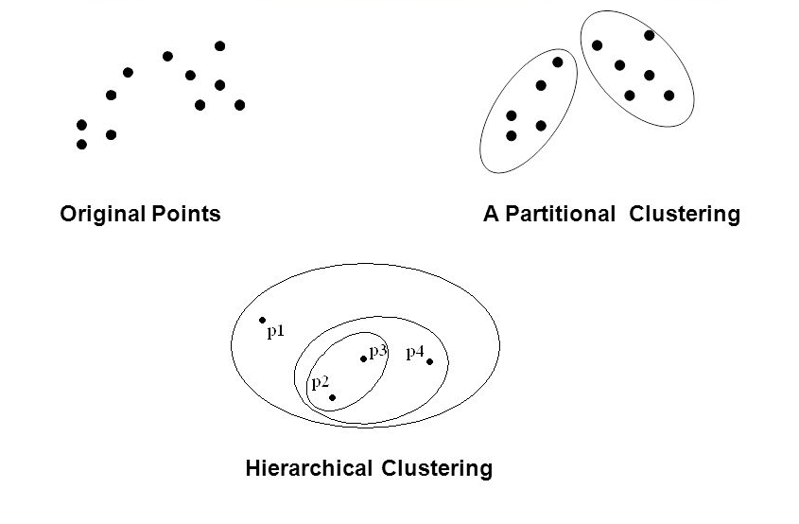
Clustering Mechanisms

Slide 7
K-Means Clustering
K-means is one of the unsupervised learning partitioning algorithms
It is also a method of vector quantization
K-means clustering aims to partition ‘n’ observations into ‘k’ clusters

Slide 8

K-Means Clustering
The cluster selection formula goes like,
where,
n is the number of objects or elements given,
k is the number of clusters given,
m_{j} is the mean of the j^{th} cluster,
o_{i} is the object/element from the input set O.
$$\sum_{i=1}^{n}{\sum_{j=1}^{k}{\left|m_{j}−o_{i}\right|}}$$

Slide 9


Types of differences in K-Means Clustering
There are basically two types of finding the difference while finding cluster elements.
They are :
Eucledian distance :
Manhattan distance :

Slide 10
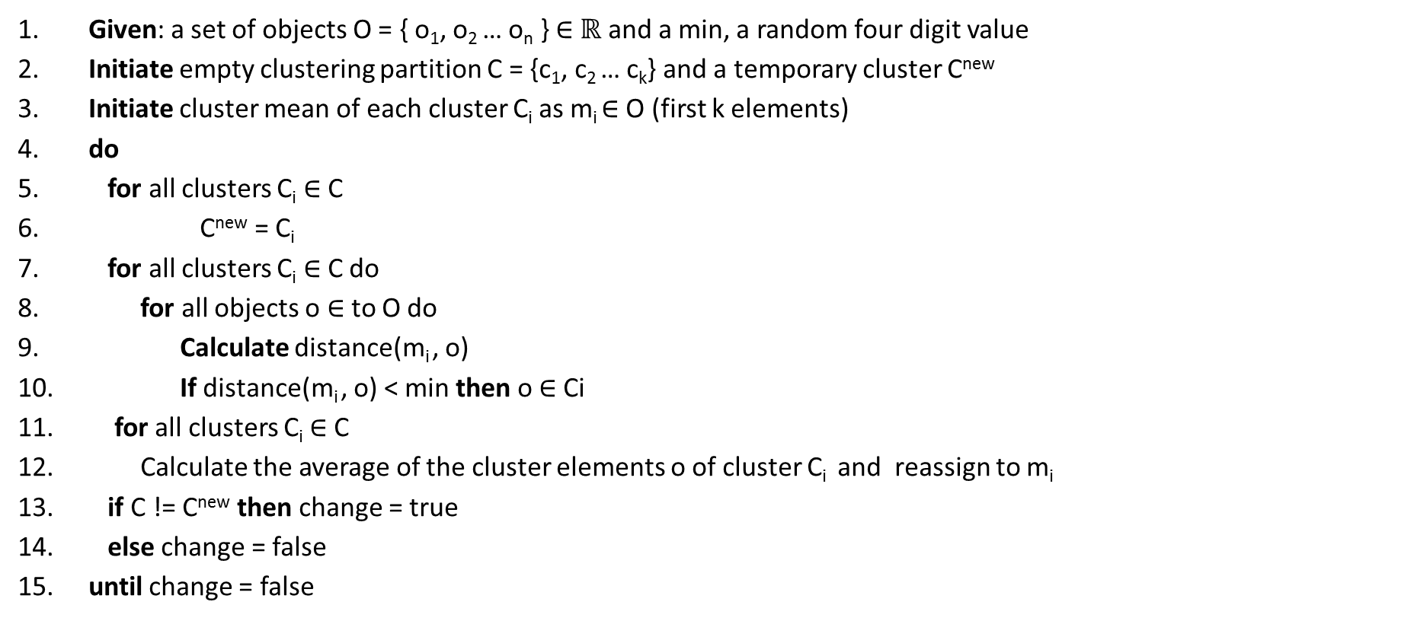
K-Means Clustering Algorithm
Given: a set of objects O = { o₁, o₂ … o_{n} } ∈ $ℝ$ and a min, a random four digit value
Initiate empty clustering partition C = {c₁, c₂ … c_{k}} and a temporary cluster C^{new}
Initiate cluster mean of each cluster C_{i} as m_{i} ∈ O (first k elements)
do
for all clusters C_{i} ∈ C
C^{new} = C_{i}
for all clusters C_{i} ∈ C do
for all objects o ∈ to O do
Calculate distance(m_{i} , o)
If distance(m_{i} , o) < min then o ∈ Ci
for all clusters C_{i} ∈ C
Calculate the average of the cluster elements o of cluster C_{i} and reassign to m_{i}
if C != C^{new} then change = true
else change = false
until change = false

Slide 11
K-Means Clustering Example
Let the input sequence be : 23 34 45 32 11 and k=3
Pass 1:
c1_mean :: 23
c2_mean :: 34
c3_mean :: 45

Slide 12
K-Means Clustering Example
Placing 23
abs(c1_mean - 23) = 0
abs(c2_mean - 23) = 11
abs(c3_mean - 23) = 22
Placed in c1
Let the input sequence be : 23 34 45 32 11
Pass 1:
c1_mean :: 23
c2_mean :: 34
c3_mean :: 45
c1: 23
c2:
c3:

Slide 13
K-Means Clustering Example
Placing 34
abs(c1_mean - 34) = 11
abs(c2_mean - 34) = 0
abs(c3_mean - 34) = 11
Placed in c2
Let the input sequence be : 23 34 45 32 11
Pass 1:
c1_mean :: 23
c2_mean :: 34
c3_mean :: 45
c1: 23
c2: 34
c3:

Slide 14
K-Means Clustering Example
Placing 45
abs(c1_mean - 45) = 22
abs(c2_mean - 45) = 11
abs(c3_mean - 45) = 0
Placed in c3
Let the input sequence be : 23 34 45 32 11
Pass 1:
c1_mean :: 23
c2_mean :: 34
c3_mean :: 45
c1: 23
c2: 34
c3: 45

Slide 15
K-Means Clustering Example
Placing 32
abs(c1_mean - 32) = 9
abs(c2_mean - 32) = 2
abs(c3_mean - 32) = 13
Placed in c2
Let the input sequence be : 23 34 45 32 11
Pass 1:
c1_mean :: 23
c2_mean :: 34
c3_mean :: 45
c1: 23
c2: 34, 32
c3: 45

Slide 16
K-Means Clustering Example
Placing 11
abs(c1_mean - 11) = 12
abs(c2_mean - 11) = 23
abs(c3_mean - 11) = 34
Placed in c1
Let the input sequence be : 23 34 45 32 11
Pass 1:
c1_mean :: 23
c2_mean :: 34
c3_mean :: 45
c1: 23, 11
c2: 34, 32
c3: 45

Slide 17
K-Means Clustering Example
Placing 23
abs(c1_mean - 23) = 6
abs(c2_mean - 23) = 10
abs(c3_mean - 23) = 22
Placed in c1
Let the input sequence be : 23 34 45 32 11
Pass 2:
c1_mean :: 17
c2_mean :: 33
c3_mean :: 45
c1: 23, 11
c2: 34, 32
c3: 45
c1: 23
c2:
c3:

Slide 18
K-Means Clustering Example
Placing 34
abs(c1_mean - 34) = 17
abs(c2_mean - 34) = 1
abs(c3_mean - 34) = 11
Placed in c2
Let the input sequence be : 23 34 45 32 11
Pass 2:
c1_mean :: 17
c2_mean :: 33
c3_mean :: 45
c1: 23, 11
c2: 34, 32
c3: 45
c1: 23
c2: 34
c3:

Slide 19
K-Means Clustering Example
Placing 45
abs(c1_mean - 45) = 28
abs(c2_mean - 45) = 12
abs(c3_mean - 45) = 0
Placed in c3
Let the input sequence be : 23 34 45 32 11
Pass 2:
c1_mean :: 17
c2_mean :: 33
c3_mean :: 45
c1: 23, 11
c2: 34, 32
c3: 45
c1: 23
c2: 34
c3: 45

Slide 20
K-Means Clustering Example
Placing 32
abs(c1_mean - 32) = 15
abs(c2_mean - 32) = 1
abs(c3_mean - 32) = 13
Placed in c2
Let the input sequence be : 23 34 45 32 11
Pass 2:
c1_mean :: 17
c2_mean :: 33
c3_mean :: 45
c1: 23, 11
c2: 34, 32
c3: 45
c1: 23
c2: 34, 32
c3: 45

Slide 21
K-Means Clustering Example
Placing 11
abs(c1_mean - 11) = 6
abs(c2_mean - 11) = 22
abs(c3_mean - 11) = 34
Placed in c1
Let the input sequence be : 23 34 45 32 11
Pass 2:
c1_mean :: 17
c2_mean :: 33
c3_mean :: 45
c1: 23, 11
c2: 34, 32
c3: 45
c1: 23, 11
c2: 34, 32
c3: 45

Slide 22
K-Means Clustering Example
Let the input sequence be : 23 34 45 32 11
old cluster new cluster
No change in clusters indicates the end of process – convergence!
c1: 23, 11
c2: 34, 32
c3: 45
c1: 23, 11
c2: 34, 32
c3: 45

Slide 23
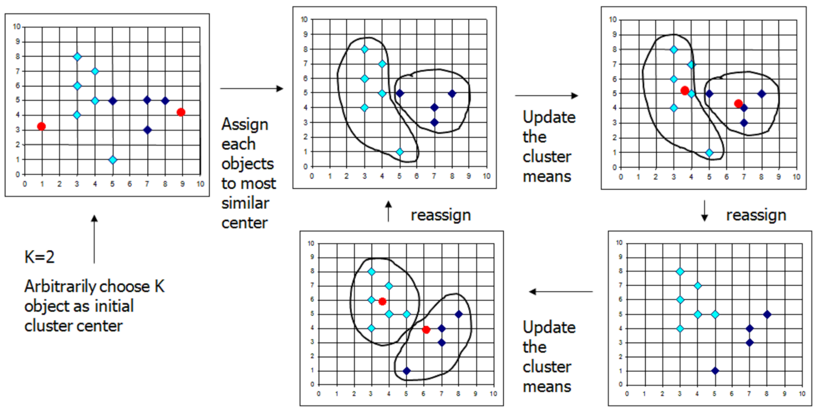
K-Means Clustering

Slide 24
Where is Learning in K-Means ?
Each object is assigned automatically to one of the cluster
This is a trait of “unsupervised learning”
The learning process depends on the training examples that we give
Thus after the training finished, if we give a point, the algorithm can assign this point to one of the existing distribution

Slide 25
Drawbacks of K-Means
When the numbers of data are not so many, initial grouping will determine the cluster significantly.
The number of cluster, K, must be determined before hand.
We never know the real cluster, using the same data, if it is inputted in a different way may produce different result
Finding mean is sensitive to the outlier of each cluster

Slide 26
K-Medoids
In K-medoids clustering representative objects called medoids are considered instead of centroids
Because it is based on the most centrally located object in a cluster, it is less sensitive to outliers.
Among many algorithms for K-medoids clustering, Partitioning Around Medoids (PAM) proposed by Kauf-man and Rousseeuw (1990) is known to be most powerful

Slide 27
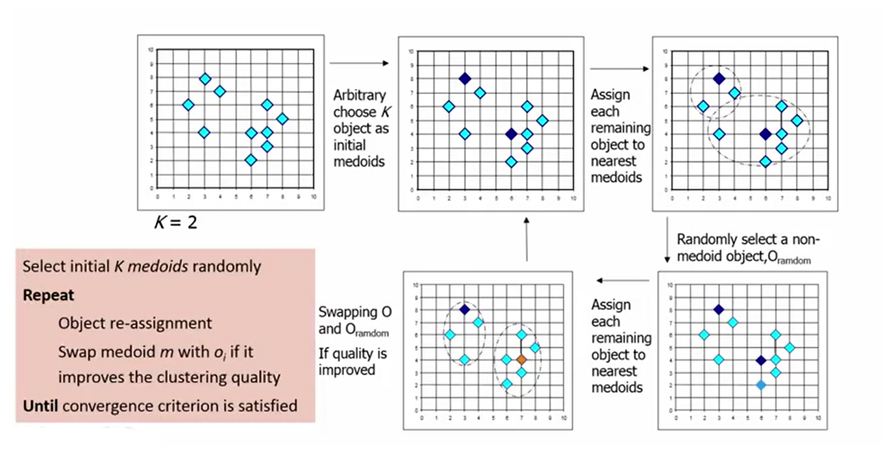
K-Medoids

Slide 28
K-Means vs K-Medoids
k-means will select the "center" of the cluster, while k-medoid will select the "most centered" member of the cluster.
In a cluster with outliers k-means will place the center of the cluster towards the outliers, whereas k-medoid will select one of the more clustered members (the medoid) as the center.
Usually, PAM takes much longer to run than k-means. As it involves computing all pairwise distances, it is O(n²*k*i); whereas k-means runs in O(n*k*i) where usually, k times the number of iterations is k*i << n.

Slide 29
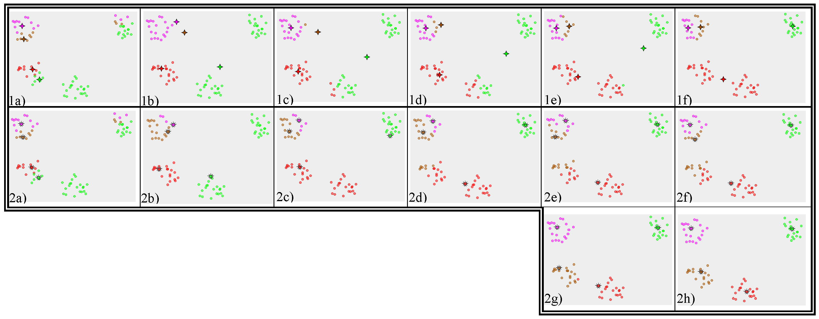
K-Means vs K-Medoids

Slide 30
Elbow Method
The Elbow method looks at the percentage of variance explained as a function of the number of clusters
One should choose a number of clusters so that adding another cluster doesn't give much better modeling of the data
The number of clusters is chosen at this point, hence the "elbow criterion"

Slide 31
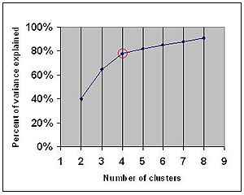
Elbow Method
Number of clusters that are initiated to 2 are incremented after each loop
After each loop until the error between the consecutive clusters become the minimum
Then we can find the elbow point

Slide 32



Elbow Method
The method works like this :
where is the mean of the Cluster number i and is the elements in Cluster no. i .
$$\sum_{i=1}^{k}{\sum_{xεC_{i}}{μ_{i}}}−x$$
$$μ_{i}$$
$$C_{i}$$

Slide 33
This Semester
K-means clustering algorithm
User input and also asking for the number of clusters to be formed
Inputs from a file that contains a set of single data values.
Implementation of k-means algorithm on data values which are in pairs such (height, weight) of persons
Application of Elbow Method to find the elbow point

Slide 34
Tasks Ahead
Pictorial representation of clusters in Pie/Bar Chart
Application of K-medoids algorithm to remove the outliers while cluster formation.

Slide 35
Conclusion
Data clustering is an unsupervised data analysis and data mining technique.
Hundreds of clustering algorithms have been developed but I got the chance to discuss a few.
The intention of my project is to present a special class of clustering algorithms, namely K-means and K-medoids.

Slide 36
References
https://en.wikipedia.org/wiki/Cluster_analysis
Data Mining: Concepts and Techniques, Jiawei Han.
https://sites.google.com/site/dataclusteringalgorithms/k-means-clustering-algorithm
https://en.wikipedia.org/wiki/K-means_clustering
https://en.wikipedia.org/wiki/K-medoids
https://www.researchgate.net/publication/220215167_A_simple_and_fast_algorithm_for_K-medoids_clustering
www.google.com/images
www.bing.com/images

Slide 37
Thank You..

